Slide 1
SARS2 & adaptive immunity
Huitian Diao
08.12.2020

Slide 2
Key points
General characteristics of COVID immune response
Characteristics of T cell response in COVID patients
Correlation of T cell response and disease outcome

Slide 3
Key points
General characteristics of COVID immune response
Characteristics of T cell response in COVID patients
Correlation of T cell response and disease outcome

Slide 4
Stages of SARS-CoV2 infection
Asymptomatic incubation period (with / without detectable virus)
Non-severe symptomatic period (with presence of virus)
Severe respiratory symptomatic stage (high viral load)
Shi, Yufang, et al. "COVID-19 infection: the perspectives on immune responses." (2020): 1451-1454.

Slide 5
Prevalent impact of SARS2-CoV-2 infection
Wadman, Meredith, et al. "A rampage through the body." (2020): 356-360.

Slide 6
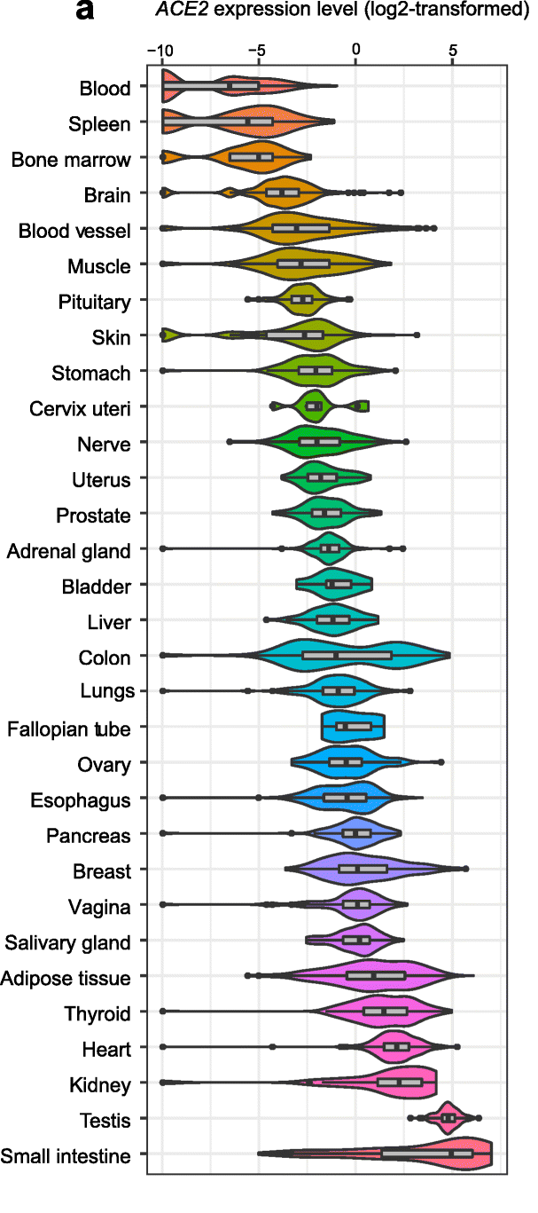
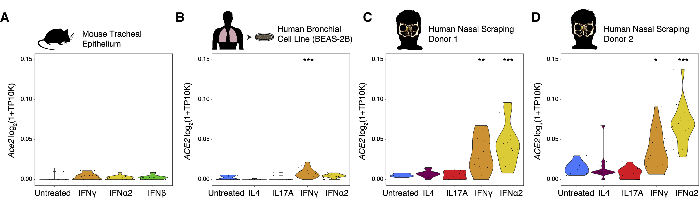
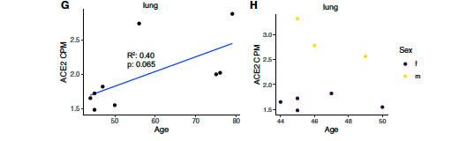
ACE2: expressed in wide variety of tissues expression can be induced by interferon; correlated with age & sex
* low basal expression of ACE2 shown in same article with scRNA-seq
*female
*age 40-50 selected
Li, Meng-Yuan, et al. "Expression of the SARS-CoV-2 cell receptor gene ACE2 in a wide variety of human tissues." Infectious diseases of poverty 9 (2020): 1-7.
Ziegler, Carly GK, et al. "SARS-CoV-2 receptor ACE2 is an interferon-stimulated gene in human airway epithelial cells and is detected in specific cell subsets across tissues." Cell (2020).
Lukassen, Soeren, et al. "SARS‐CoV‐2 receptor ACE 2 and TMPRSS 2 are primarily expressed in bronchial transient secretory cells." The EMBO journal 39.10 (2020): e105114.
Notes:
Left: GTEx database
Right: primary cell culture, bulk RNA-seq
Bottom right: count per million

Slide 7
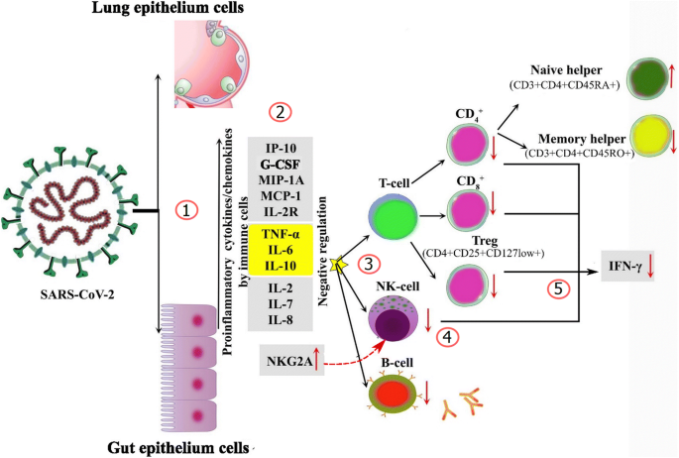
Immunological profile of COVID19
Type I IFNs
Neutrophil
Mahmoudi, Shima, et al. "Immunologic Features in Coronavirus Disease 2019: Functional exhaustion of t cells and cytokine storm." Journal of Clinical Immunology (2020): 1-3.
Qin, Chuan, et al. "Dysregulation of immune response in patients with COVID-19 in Wuhan, China." Clinical Infectious Diseases (2020).

Slide 8
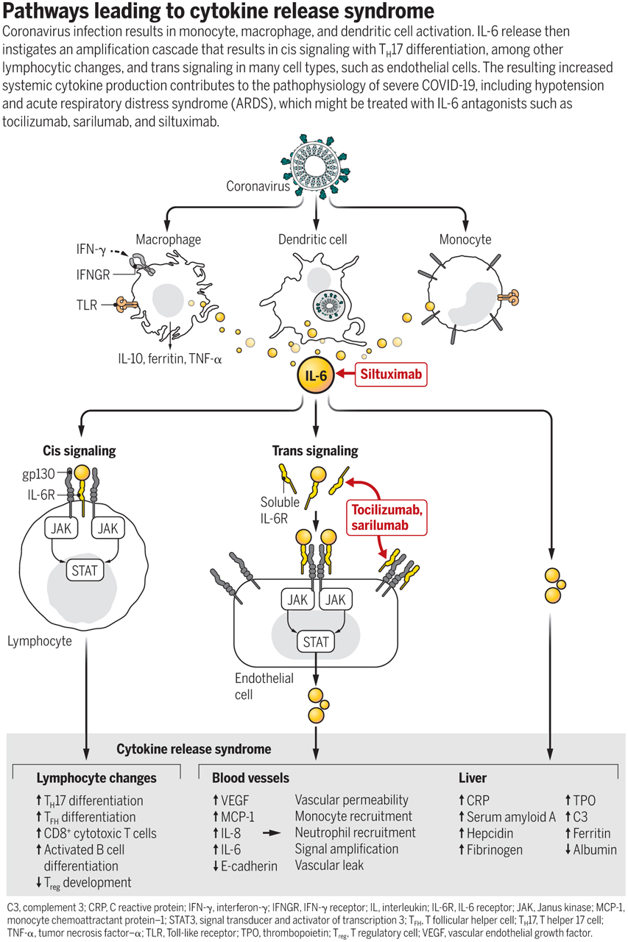
Cytokine release syndrome in COVID19
Moore, John B., and Carl H. June. "Cytokine release syndrome in severe COVID-19." Science 368.6490 (2020): 473-474.

Slide 9
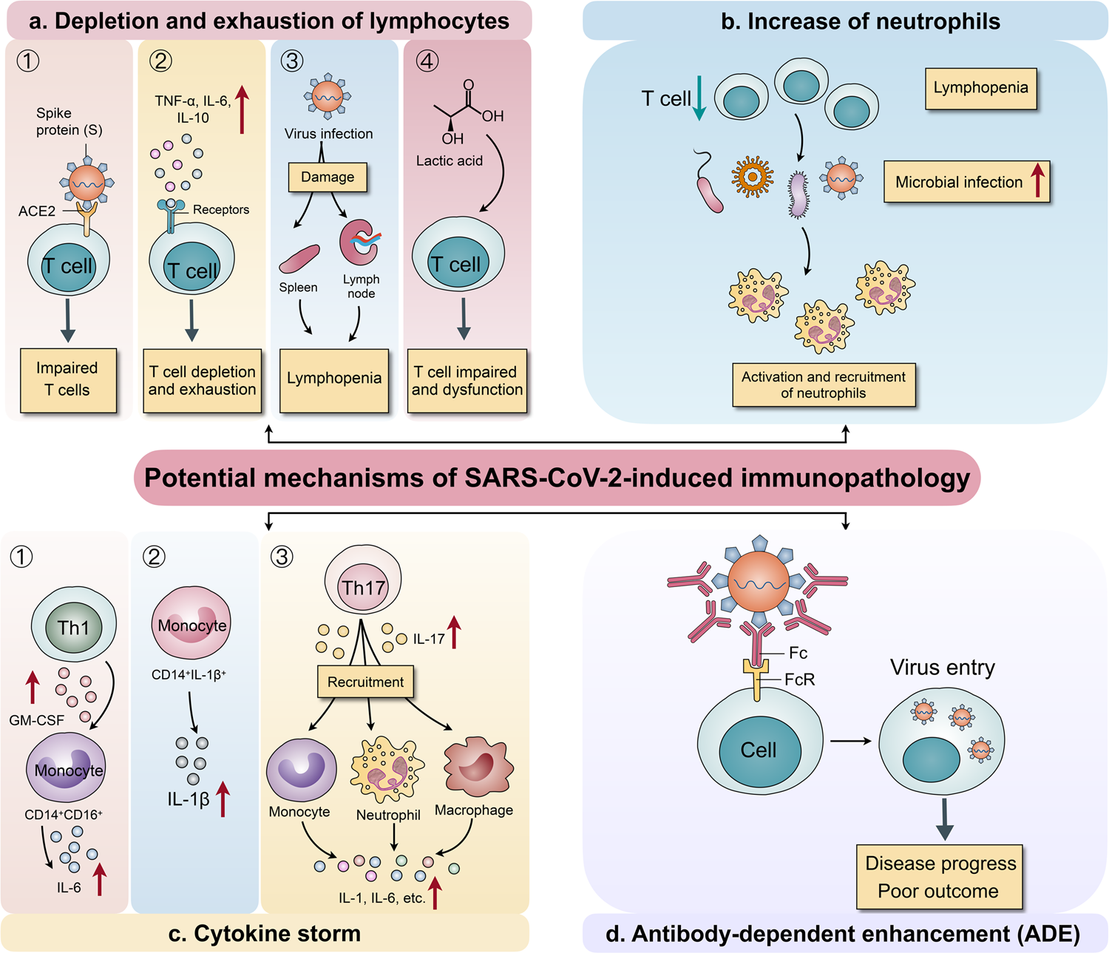
Potential mechanisms of SARS-CoV2-induced immunopathology
Yang, Li, et al. "COVID-19: immunopathogenesis and Immunotherapeutics." Signal Transduction and Targeted Therapy 5.1 (2020): 1-8.

Slide 10
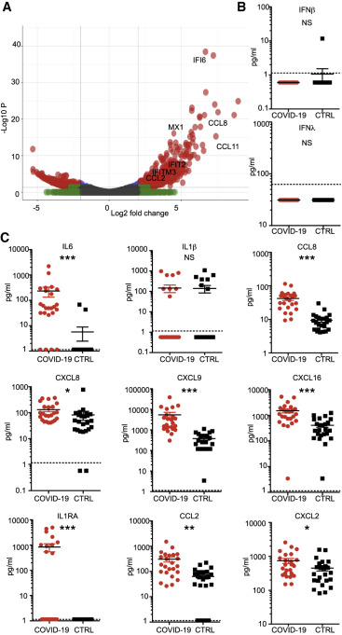
COVID19 patients: low type 1 & 3 interferon, high chemokine
Serum ELISA for protein expression levels
Blanco-Melo, Daniel, et al. "Imbalanced host response to SARS-CoV-2 drives development of COVID-19." Cell (2020).

Slide 11
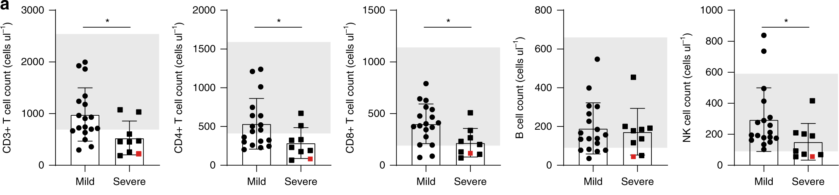
More severe reduction of T / B / NK cell count in severe COVID19 patients
Song, Jin-Wen, et al. "Immunological and inflammatory profiles in mild and severe cases of COVID-19." Nature communications 11.1 (2020): 1-10.

Slide 12
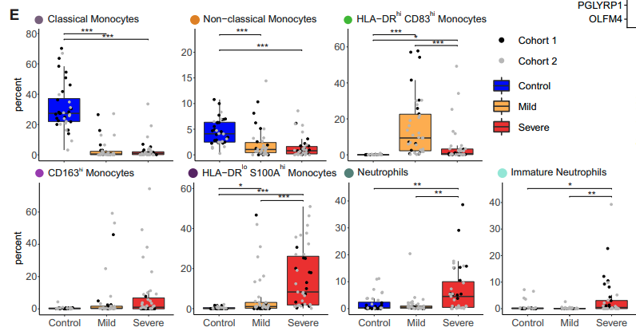
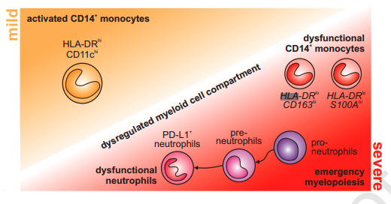
Dysregulated myeloid cell compartment in severe COVID19 cases
Percentage of cells in PBMC
Schulte-Schrepping, Jonas, et al. "Severe COVID-19 is marked by a dysregulated myeloid cell compartment." Cell (2020).

Slide 13
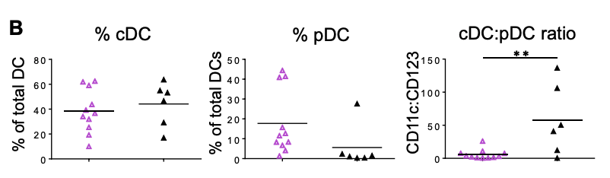
Altered cDC : pDC ratio in severe COVID19 cases
Percentage of total blood DC
Mild Severe
Mild Severe
Mild Severe
Zhou, Runhong, et al. "Acute SARS-CoV-2 infection impairs dendritic cell and T cell responses." Immunity (2020).
Notes:
Frequencies of CD11c+ cDC and CD123+ 548 pDC in total blood DC, and the cDC:pDC ratios 549 were determined by flow cytometry

Slide 14
Key points
General characteristics of COVID immune response
Characteristics of T cell response in COVID patients
Correlation of T cell response and disease outcome

Slide 15
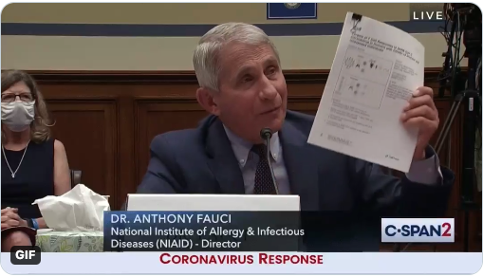
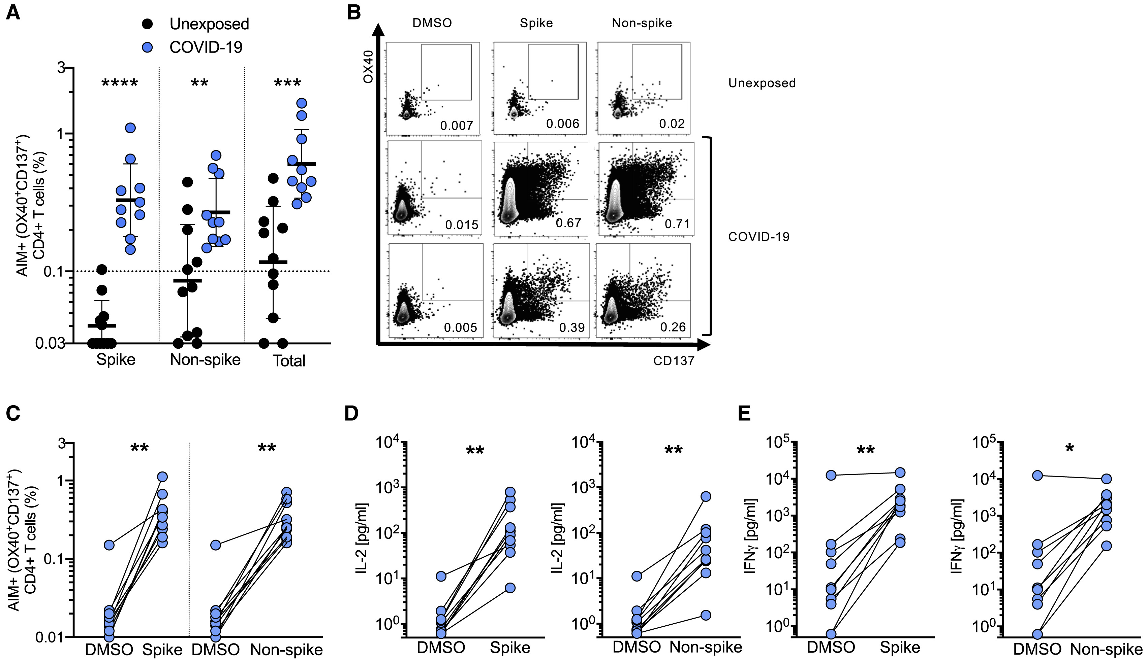
CD4 T cell specificity for SARS-Cov2 in recovered COVID19 patient
Grifoni, Alba, et al. "Targets of T cell responses to SARS-CoV-2 coronavirus in humans with COVID-19 disease and unexposed individuals." Cell (2020).
Notes:
T cell receptor (TCR) dependent activation induced marker (AIM) assays to identify and quantify SARS-CoV-2-specific CD4⁺ T cells: https://pubmed.ncbi.nlm.nih.gov/27335502/

Slide 16
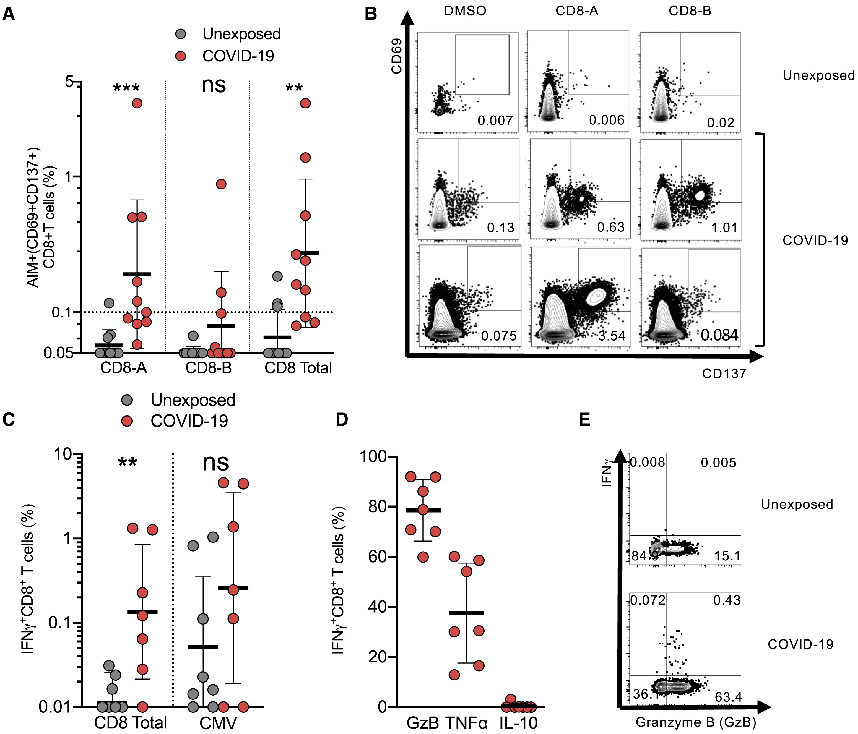
CD8 T cell specificity for SARS-Cov2 in recovered COVID19 patient
Grifoni, Alba, et al. "Targets of T cell responses to SARS-CoV-2 coronavirus in humans with COVID-19 disease and unexposed individuals." Cell (2020).
Notes:
Stimulated with SARS2 / CMV MP(mega pool peptides)
D: Functional profile of IFN-γ⁺CD8⁺ T cells producing granzyme B (GzB), TNF-α (TNF), or IL-10 in response to SARS-CoV-2 MPs. Mean and SD are shown

Slide 17
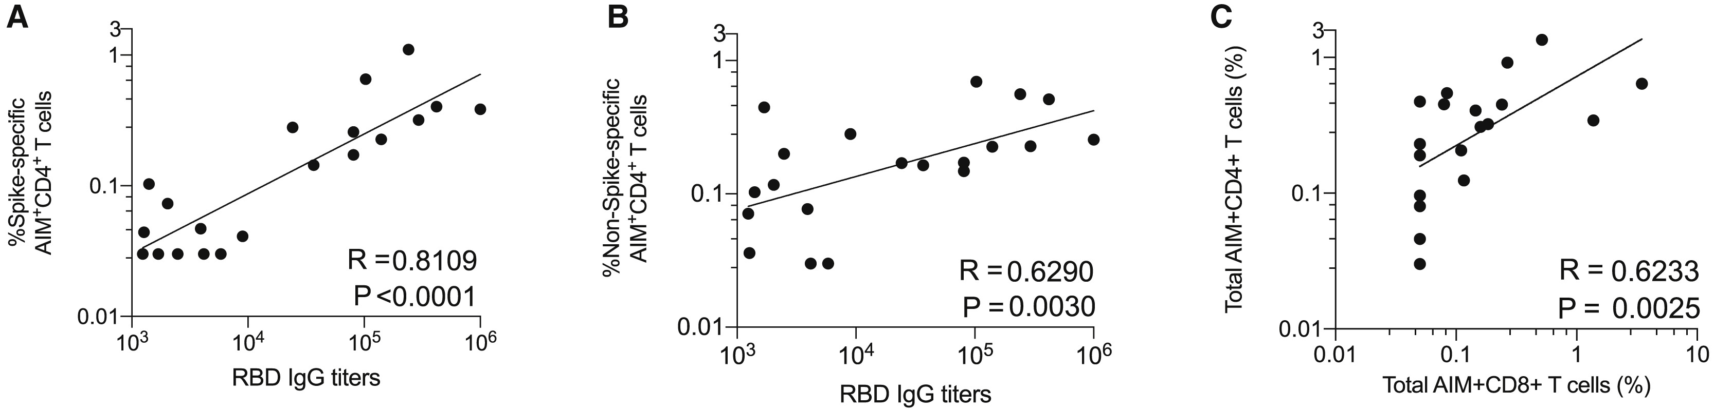
Correlation between antibody, CD4 and CD8 response in COVID19 patients
Grifoni, Alba, et al. "Targets of T cell responses to SARS-CoV-2 coronavirus in humans with COVID-19 disease and unexposed individuals." Cell (2020).
Notes:
Stimulated with SARS2 / CMV MP(mega pool peptides)
D: Functional profile of IFN-γ⁺CD8⁺ T cells producing granzyme B (GzB), TNF-α (TNF), or IL-10 in response to SARS-CoV-2 MPs. Mean and SD are shown

Slide 18
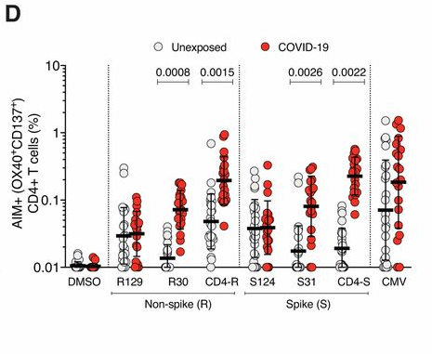
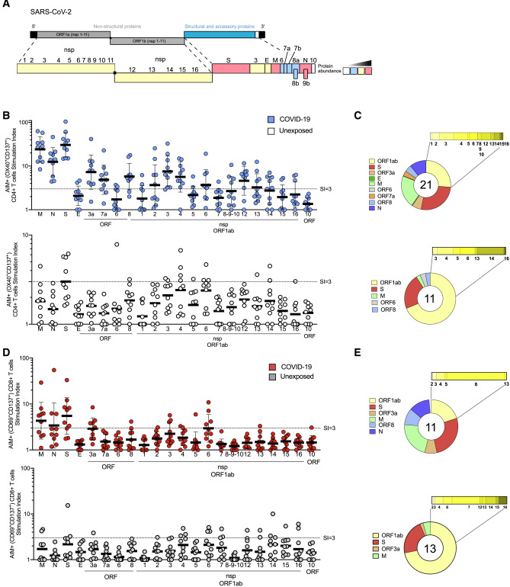
Cross-reactivity of T cell for Common cold virus and SARS-CoV-2
Fraction of SARS-CoV-2 proteins recognized by T cells in
COVID-19 cases (top) and unexposed donors (bottom)
CD4
CD8
* R129: common cold peptide pool
* R30: SARS2 non spike - high response pool
* S31: SARS2 spike - high response pool
* CD4-R: SARS2 non spike mega pool
* CD4-S: SARS2 spike mega pool
Grifoni, Alba, et al. "Targets of T cell responses to SARS-CoV-2 coronavirus in humans with COVID-19 disease and unexposed individuals." Cell (2020).
Mateus, Jose, et al. "Selective and cross-reactive SARS-CoV-2 T cell epitopes in unexposed humans." Science (2020).

Slide 19
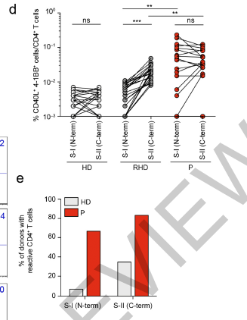
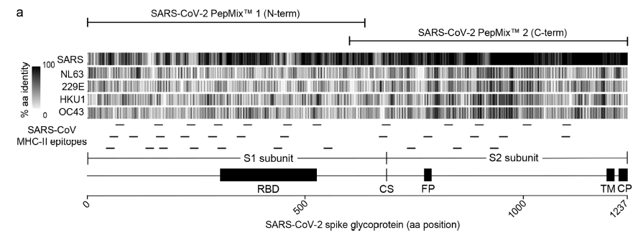
> 30% non-SARS-CoV2 exposed people have CD4 T cells reactive to S2 subunit
SARS-CoV2 S2 subunit have higher similarity to common cold than S1
*HD: non exposed healthy donor
*RHD: reactive non exposed healthy donor
Braun, Julian, et al. "SARS-CoV-2-reactive T cells in healthy donors and patients with COVID-19." Nature 10 (2020).
Le Bert, Nina, et al. "SARS-CoV-2-specific T cell immunity in cases of COVID-19 and SARS, and uninfected controls." Nature (2020): 1-10.
Notes:
CD4 T cells stimulated for 16 hours with S-I and S-II peptide pools. Antigen-reactive CD4 T cells were identified by co-expression of 4-1BB and CD40L

Slide 20
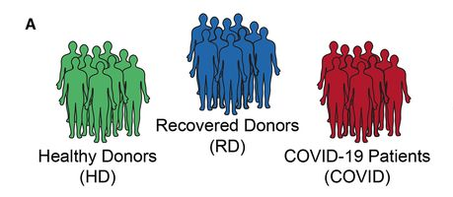
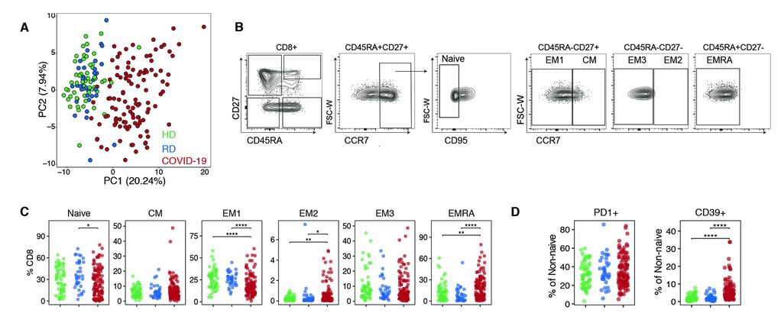
CD8 T cell phenotype in COVID patients
Mathew, Divij, et al. "Deep immune profiling of COVID-19 patients reveals distinct immunotypes with therapeutic implications." Science (2020).

Slide 21
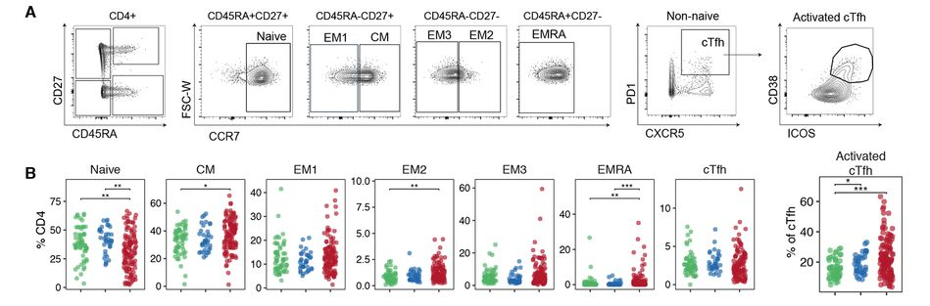
CD4 T cell phenotype in COVID patients
Mathew, Divij, et al. "Deep immune profiling of COVID-19 patients reveals distinct immunotypes with therapeutic implications." Science (2020).

Slide 22
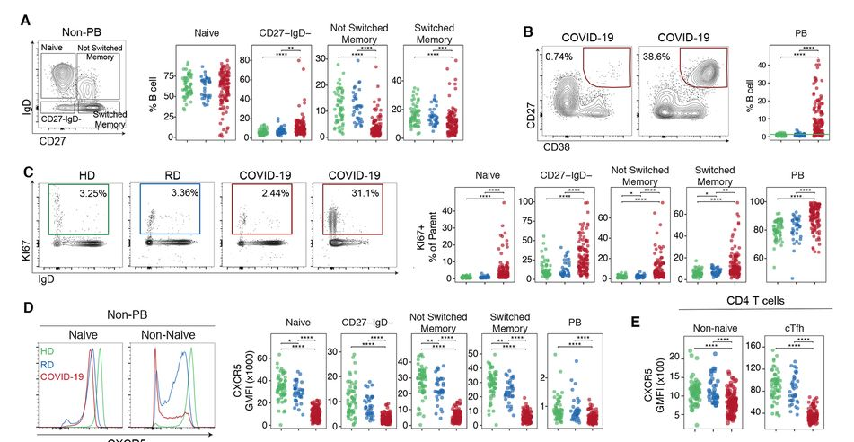
B cell phenotype in COVID patients
Mathew, Divij, et al. "Deep immune profiling of COVID-19 patients reveals distinct immunotypes with therapeutic implications." Science (2020).

Slide 23
Key points
General characteristics of COVID immune response
Characteristics of T cell response in COVID patients
Correlation of T cell response and disease outcome

Slide 24
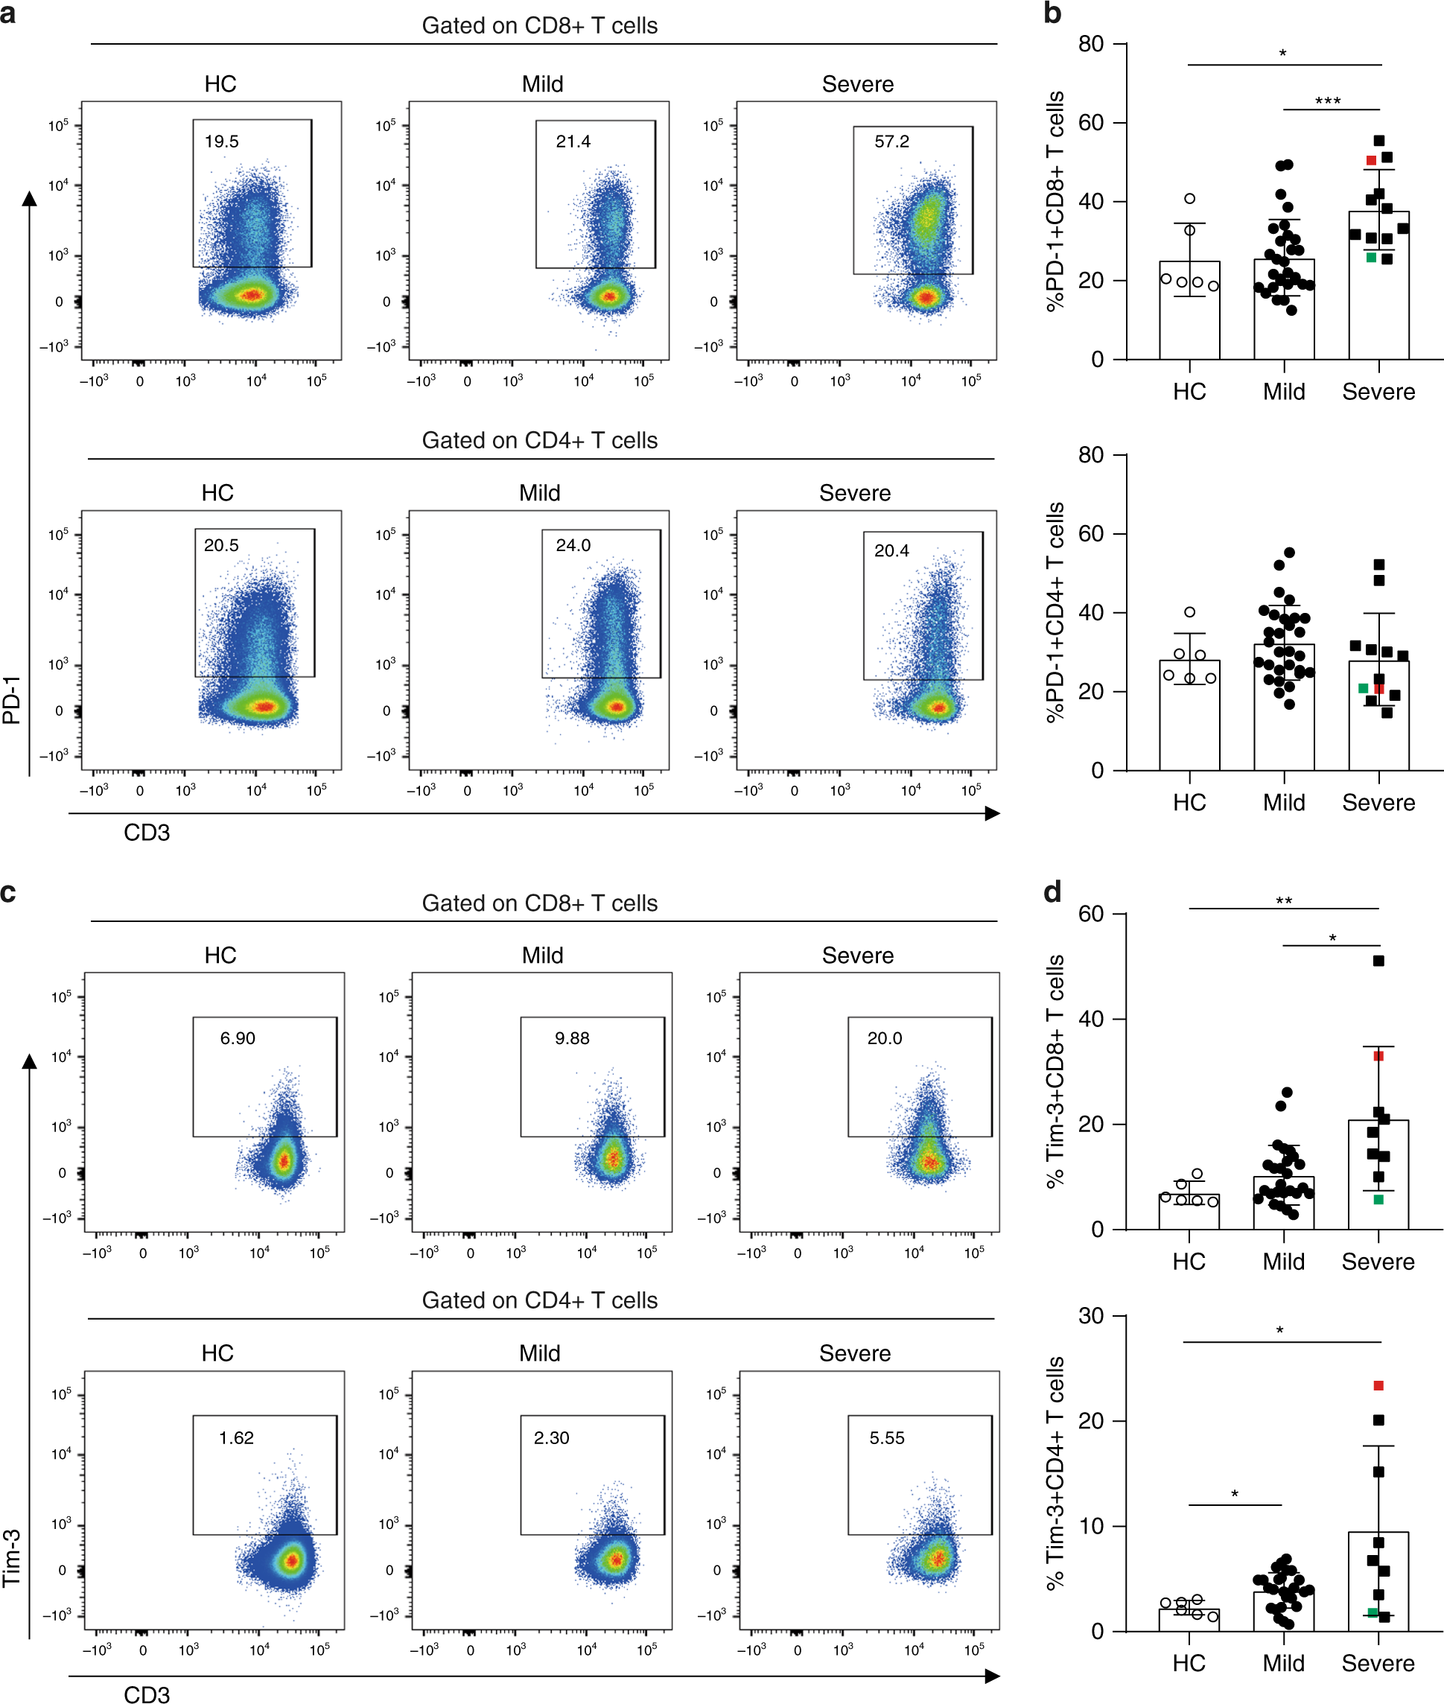
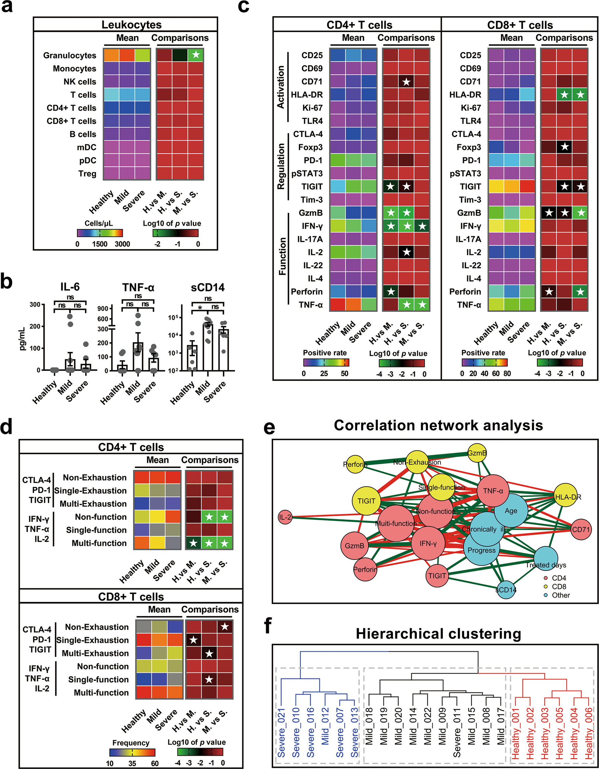
Exhaustion of T cells in severe COVID19 patients
Song, Jin-Wen, et al. "Immunological and inflammatory profiles in mild and severe cases of COVID-19." Nature communications 11.1 (2020): 1-10.
Diao, Bo, et al. "Reduction and functional exhaustion of T cells in patients with coronavirus disease 2019 (COVID-19)." Frontiers in Immunology 11 (2020): 827.
Zheng, Hong-Yi, et al. "Elevated exhaustion levels and reduced functional diversity of T cells in peripheral blood may predict severe progression in COVID-19 patients." Cellular & molecular immunology 17.5 (2020): 541-543.
Zheng, Meijuan, et al. "Functional exhaustion of antiviral lymphocytes in COVID-19 patients." Cellular & molecular immunology 17.5 (2020): 533-535.

Slide 25
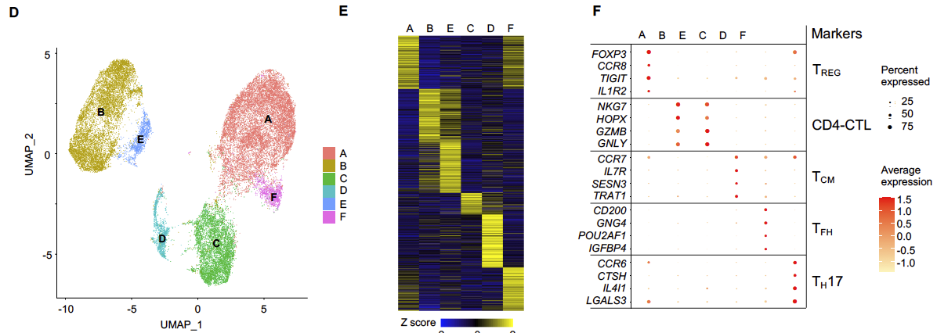
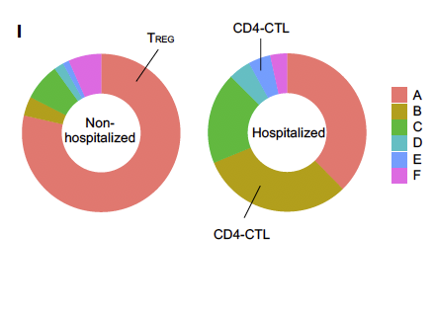
Higher fraction of Tfh & CD4 CTL in severe COVID19 patient comparing with moderate
Sorted CD137+ CD69+ memory CD4+ T cells
Post 24 hours stimulation with SARS2 mega pool peptide
Distribution % in cluster
Meckiff, Benjamin J., et al. "Single-cell transcriptomic analysis of SARS-CoV-2 reactive CD4+ T cells." Available at SSRN 3641939 (2020).
Kusnadi, Anthony, et al. "Severely ill COVID-19 patients display augmented functional properties in SARS-CoV-2-reactive CD8+ T cells." bioRxiv (2020).
Wen, Wen, et al. "Immune cell profiling of COVID-19 patients in the recovery stage by single-cell sequencing." Cell discovery 6.1 (2020): 1-18.

Slide 26
Conclusion
General characteristics of COVID immune response
Wide variety of organs affected
Altered interferon response
Increased neutrophil & decreased T / B / NK cells
Characteristics of T cell response in COVID patients
Most recovered patients harbor SARS2 reactive T cells
Cross reactivity of common cold virus, SARS and SARS2
Altered T cell phenotype distribution in SARS2
Correlation of T cell response and disease outcome
Severe outcome correlated with T cell exhaustion & altered phenotype distribution of T cells

Slide 27
Q & A

